Slide 1
Machine Learning
Bayesian Classification

Slide 2
MACHINE LEARNING
Humans can supply rules to logical reasoning programs
Another way is to impart the ability of constructing rules to the machines themselves. This is called Machine Learning
The machine is given raw data and it is supposed to form rules (i.e. a model or concept) about the process from which the data is generated

Slide 3
Numeric Machine Learning
BAYESIAN METHODS
We begin by considering the case in which the probability structure underlying the categories is known perfectly
Why study Bayesian approach?
Bayesian learning algorithms are among the most practical approaches to certain types of learning problems. There results are comparable to the performance of other classifiers, such as decision tree and neural networks in many cases

Slide 4
BAYESIAN METHODS
Bayesian Classifiers
Bayesian classifiers are statistical classifiers, and are based on Bayes theorem
They can calculate the probability that a given sample belongs to a particular class

Slide 5
BAYESIAN METHODS
Bayes Theorem
Let X be a data sample, e.g. red and round fruit
Let H be some hypothesis, such as that X belongs to a specified class C (e.g. X is an apple)
For classification problems, we want to determine P(H|X), the probability that the hypothesis H holds given the observed data sample X

Slide 6
BAYESIAN METHODS
Prior Probability
The probability P(H) is called the prior probability of H, i.e the probability that any given data sample is an apple, regardless of how the data sample looks
The probability P(H|X) is called posterior probability. It is based on more information, than the prior probability P(H) which is independent of X

Slide 7
BAYESIAN METHODS
Posterior Probability
Example:
Let the data samples be fruits described by their colour and shape
Suppose X = red and round
and H = hypothesis that X is an apple
Then P(H|X) is the probability that X is an apple given that X is red and round

Slide 8
BAYESIAN METHODS
Bayes Theorem
It provides a way of calculating the posterior probability
P(H|X) = P(X|H) P(H)
P(X)
P(X|H) is the posterior probability of X given H (it is the probability that X is red and round given that X is an apple)
P(X) is the prior probability of X (probability that a data sample is red and round)

Slide 9
BAYESIAN METHODS
Naïve (Simple) Bayesian Classification
Studies comparing classification algorithms have found that the simple Bayesian classifier is comparable in performance with decision tree and neural network classifiers
It works as follows:
1. Each data sample is represented by an n-dimensional feature vector, X = (x₁, x₂, …, x_{n}), depicting n measurements made on the sample from n attributes, respectively A₁, A₂, … A_{n}

Slide 10
BAYESIAN METHODS
Naïve (Simple) Bayesian Classification
2. Suppose that there are m classes C₁, C₂, … C_{m}. Given an unknown data sample, X (i.e. having no class label), the classifier will predict that X belongs to the class having the highest posterior probability given X
Thus if P(C_{i}|X) > P(C_{j}|X) for 1 ≤ j ≤ m , j ≠ i
then X is assigned to C_{i}
This is called Bayes decision rule

Slide 11
BAYESIAN METHODS
Naïve (Simple) Bayesian Classification
3. We have P(C_{i}|X) = P(X|C_{i}) P(C_{i}) / P(X)
As P(X) is constant for all classes, only P(X|C_{i}) P(C_{i}) needs to be calculated, So
P(Ci|X) = P(X|Ci) P(Ci)
The class prior probabilities may be estimated by
P(C_{i}) = s_{i} / s
where s_{i} is the number of samples of class C_{i}
& s is the total number of samples
If class prior probabilities are equal (or not known and thus assumed to be equal) then we need to calculate only P(X|C_{i})

Slide 12
BAYESIAN METHODS
Naïve (Simple) Bayesian Classification
4. Given data sets with many attributes, it would be extremely computationally expensive to compute P(X|C_{i})
For example, assuming the attributes of colour and shape to be Boolean, we need to store 4 probabilities for the category apple
P(¬red ∧ ¬round | apple)
P(¬red ∧ round | apple)
P(red ∧ ¬round | apple)
P(red ∧ round | apple)
If there are 6 attributes and they are Boolean, then we need to store 2⁶ probabilities

Slide 13
BAYESIAN METHODS
Naïve (Simple) Bayesian Classification
In order to reduce computation, the naïve assumption of class conditional independence is made
This presumes that the values of the attributes are conditionally independent of one another, given the class label of the sample (we assume that there are no dependence relationships among the attributes)

Slide 14
BAYESIAN METHODS
Naïve (Simple) Bayesian Classification
Thus we assume that P(X|C_{i}) = ∏^{n}_{k=1} P(x_{k}|C_{i})
Example
P(colour ∧ shape | apple) = P(colour | apple) P(shape | apple)
For 6 Boolean attributes, we would have only 12 probabilities to store instead of 2⁶ = 64
Similarly for 6, three valued attributes, we would have 18 probabilities to store instead of 3⁶

Slide 15
BAYESIAN METHODS
Naïve (Simple) Bayesian Classification
The probabilities P(x₁|C_{i}), P(x₂|C_{i}), …, P(x_{n}|C_{i}) can be estimated from the training samples
e.g. P(red|apple) = 7/10 if 7 out of 10 apples are red

Slide 16
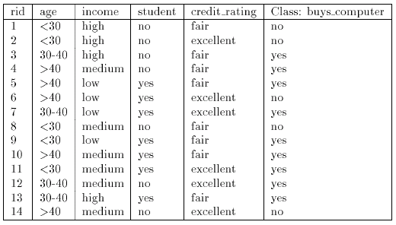
BAYESIAN METHODS
Naïve (Simple) Bayesian Classification
Example:

Slide 17
BAYESIAN METHODS
Naïve (Simple) Bayesian Classification
Example:
Let C₁ = class buy computer and C₂ = class not buy computer
The unknown sample:
X = {age = < 30, income = medium, student = yes, credit-rating = fair}
Remember the Formula
P(Ci|X) = P(X|Ci) P(Ci)
The prior probability of each class can be computed as
P(C₁) =P(buy computer = yes) = 9/14 = 0.643
P(C₂) =P(buy_computer = no) = 5/14 = 0.357

Slide 18
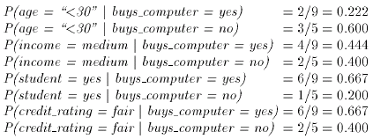
BAYESIAN METHODS
Naïve (Simple) Bayesian Classification
Example:
To compute P(X|Ci) we compute the following conditional probabilities

Slide 19
BAYESIAN METHODS
Naïve (Simple) Bayesian Classification
Example:
Using the above probabilities we obtain
As
P(Ci|X) = P(X|Ci) P(Ci)
And hence the naïve Bayesian classifier predicts that the student will buy computer.

